Slide 1

Simulating Blood Flow in the Pulmonary Artery using Physics-Informed Neural Networks
David Ortiz-Puerta
Millennium Institute for intelligent Healthcare Engineering, ihealth Pontifical Catholic University of Chile
July 29th, 2024

Slide 2
Motivation
Subject-specific Computational Fluid Dynamics (CFD) studies
PROS (CFD) (Garay 2024):
Non-invasive
In silico experimentation
Gain prediction capabilities

Slide 3
Motivation
Subject-specific Computational Fluid Dynamics (CFD) studies
PROS (CFD) (Garay 2024):
Non-invasive
In silico experimentation
Gain prediction capabilities
Application: the study of the pulmonary arterial hypertension

Slide 4
Motivation
Subject-specific Computational Fluid Dynamics (CFD) studies
PROS (CFD) (Garay 2024):
Non-invasive
In silico experimentation
Gain prediction capabilities
Application: the study of the pulmonary arterial hypertension
CONS (CFD) (Kong 2022):
Parameter sensitivity
Non-linear
Intricate geometries
Time/resources

Slide 5
Motivation
Physic-Informed Neural Networks (PINNs)
PROS (PINNs)(Moseley 2022):
(CFD)
Meshless
Mixed/coupled formulations
Incomplete models

Slide 6
Motivation
Physic-Informed Neural Networks (PINNs)
PROS (PINNs)(Moseley 2022):
(CFD)
Meshless
Mixed/coupled formulations
Incomplete models
CONS (PINNs):
Universal approximation theorem (Barron 1993)
Spectral bias (Moseley 2023, Tancik 2020)
Intricate loss landscape (Barba 2022, 2023)

Slide 7
Motivation
Physic-Informed Neural Networks (PINNs)
PROS (PINNs)(Moseley 2022):
(CFD)
Meshless
Mixed/coupled formulations
Incomplete models
What are the best hyperparameters to overcome the PINNs cons?
CONS (PINNs):
Universal approximation theorem (Barron 1993)
Spectral bias (Moseley 2023, Tancik 2020)
Intricate loss landscape (Barba 2022, 2023)

Slide 8
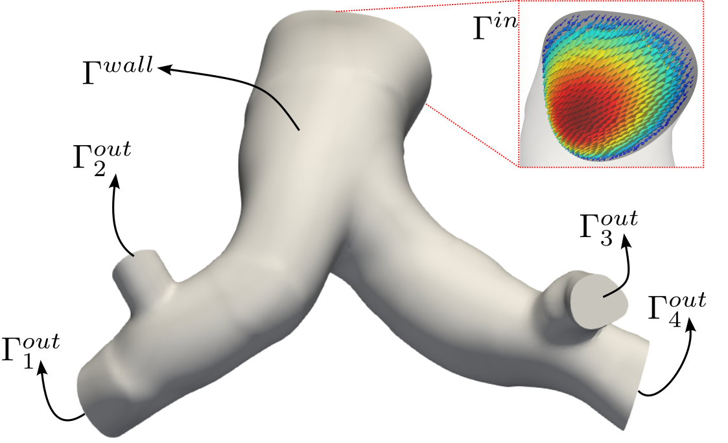
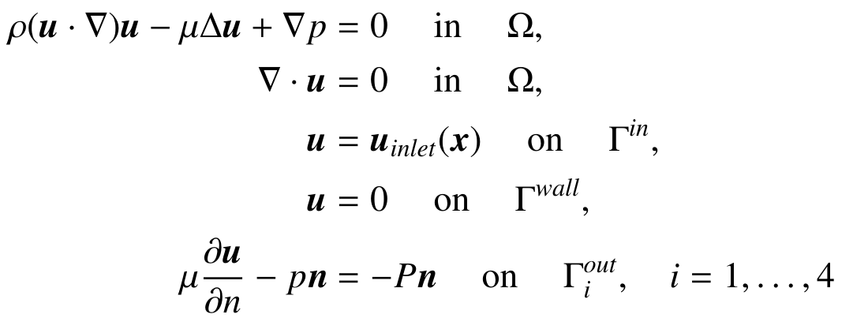
Methodology
Steady Navier-Stokes model

Slide 9
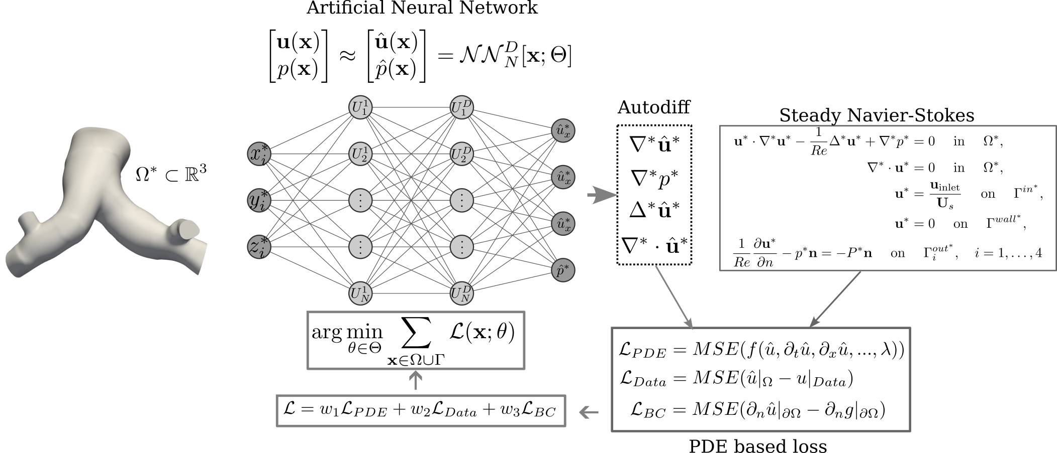
Methodology
+ Strategies to improve loss convergence (Wang 2023)

Slide 10
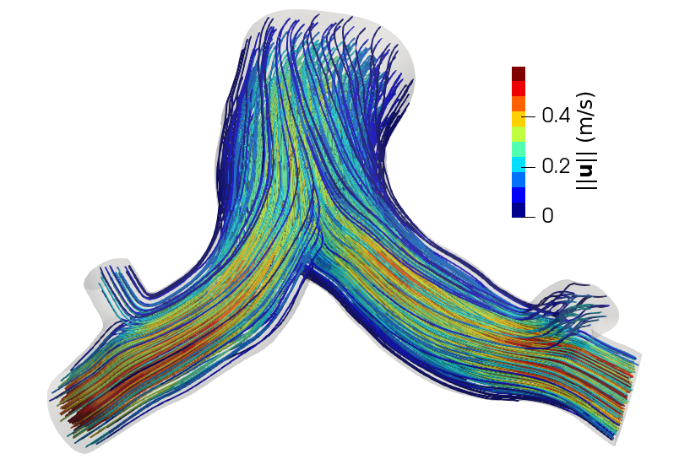
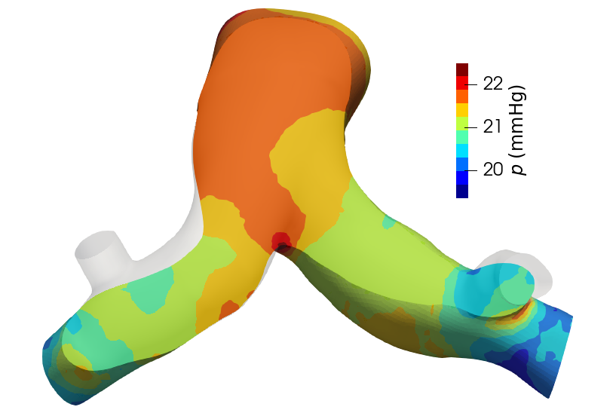
Methodology
Reference solution for testing and data
Velocity
Pressure

Slide 11
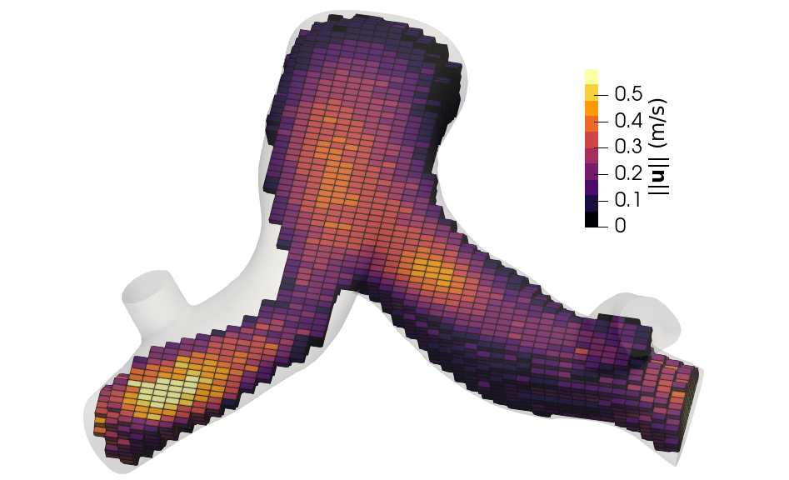
Methodology
Noisy data: SNR 20dB

Slide 12
PINN hyperparameter study:
ANN:
multi-layer perceptron (mlp),
mlp with fourier features (mlpff),
modified mlp (modmlp),
modified mlp with fourier features (modmlpff)
Activation functions:
Tanh
Swish
Gelu
Softplus
Hidden layers: 1-8
Neuron units (per layer): 10-700
Learning rate: 1e-1 - 1e-5
Fourier features: sigma 1-2, fourier features 10-256
Main objective:
to minimize relative error

Slide 13
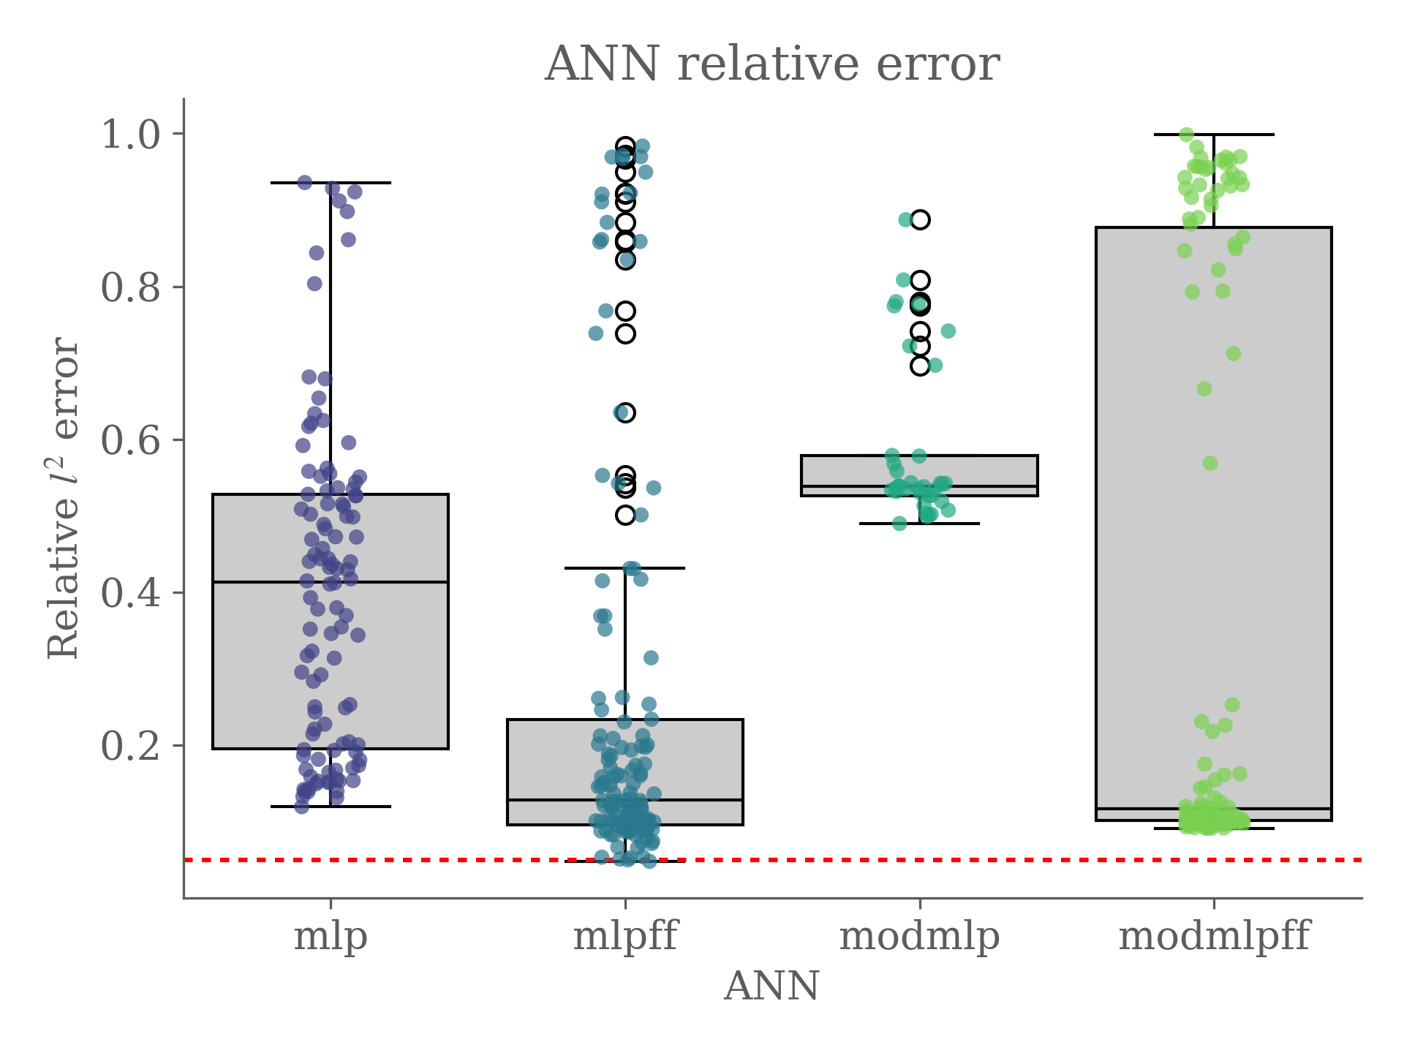
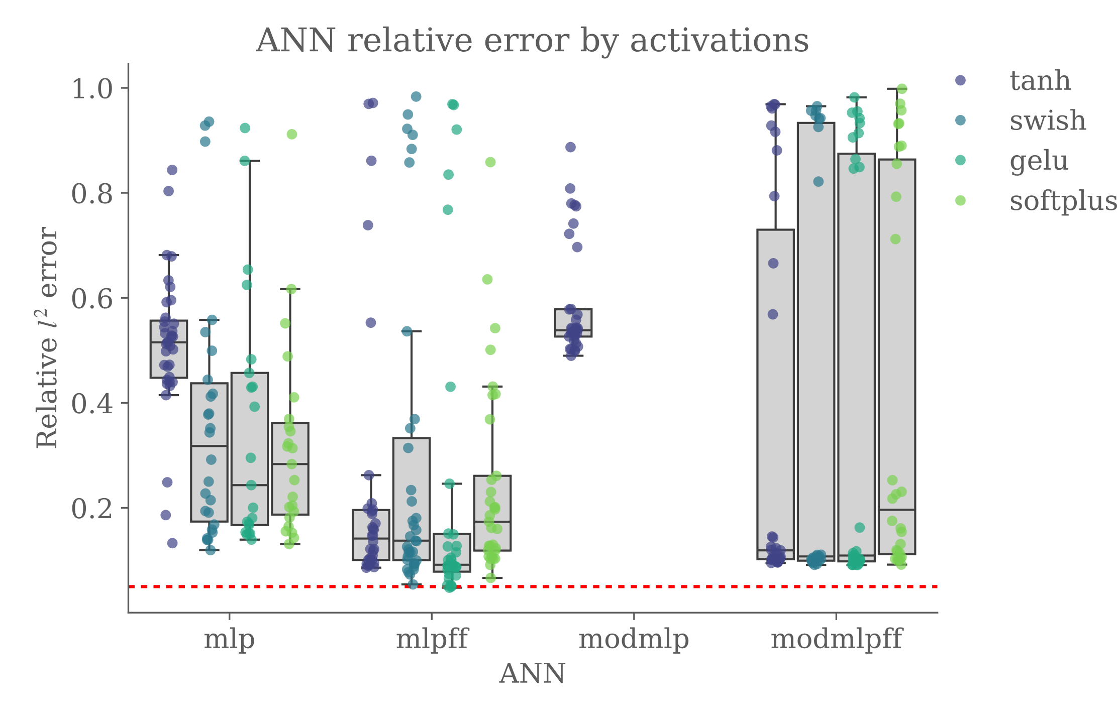
Failed cases
Failed cases
 | Mlp | Mlpff | Modmlp | Modmlpff
tanh | 3 | 6 | 3 | 8
swish | 14 | 5 | 40 | 16
gelu | 18 | 8 | 40 | 12
softplus | 17 | 6 | 40 | 11
Mlp | 53
Mlpff | 25
Modmlp | 123
Modmlpff | 47

Slide 14
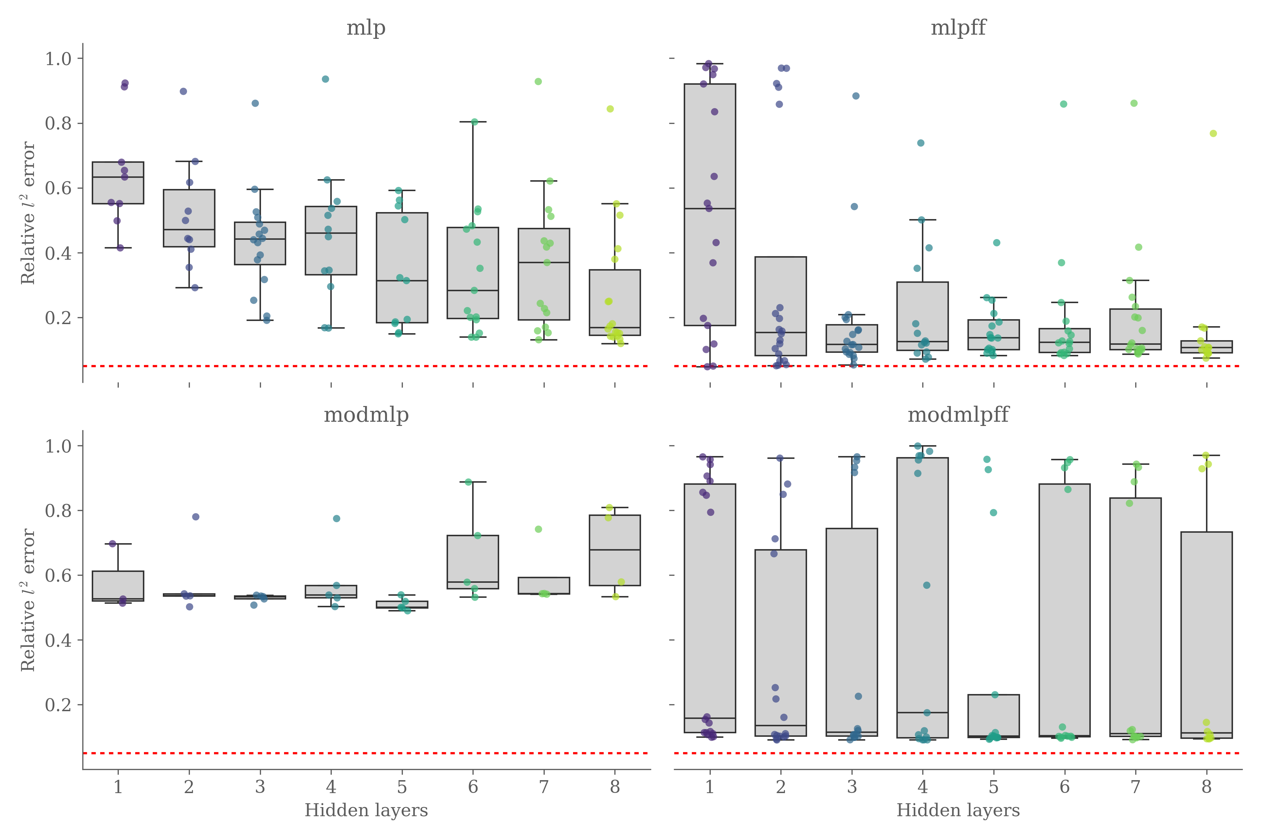
Hidden layers

Slide 15
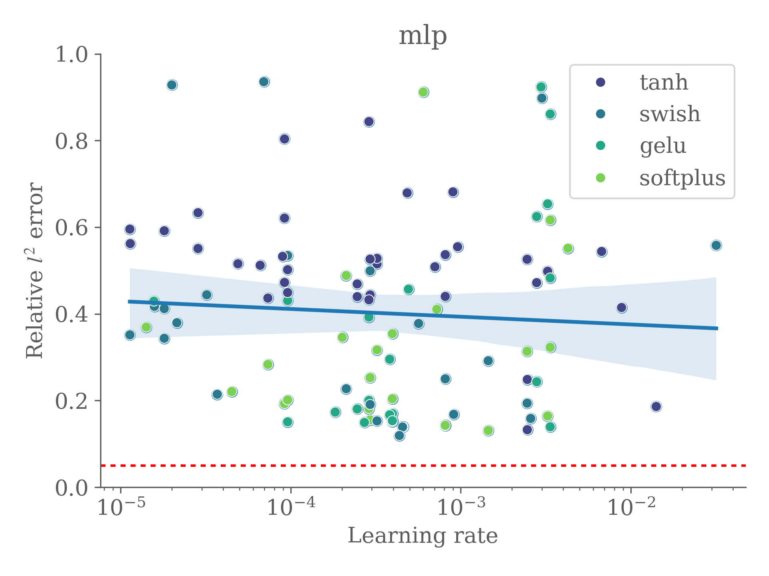
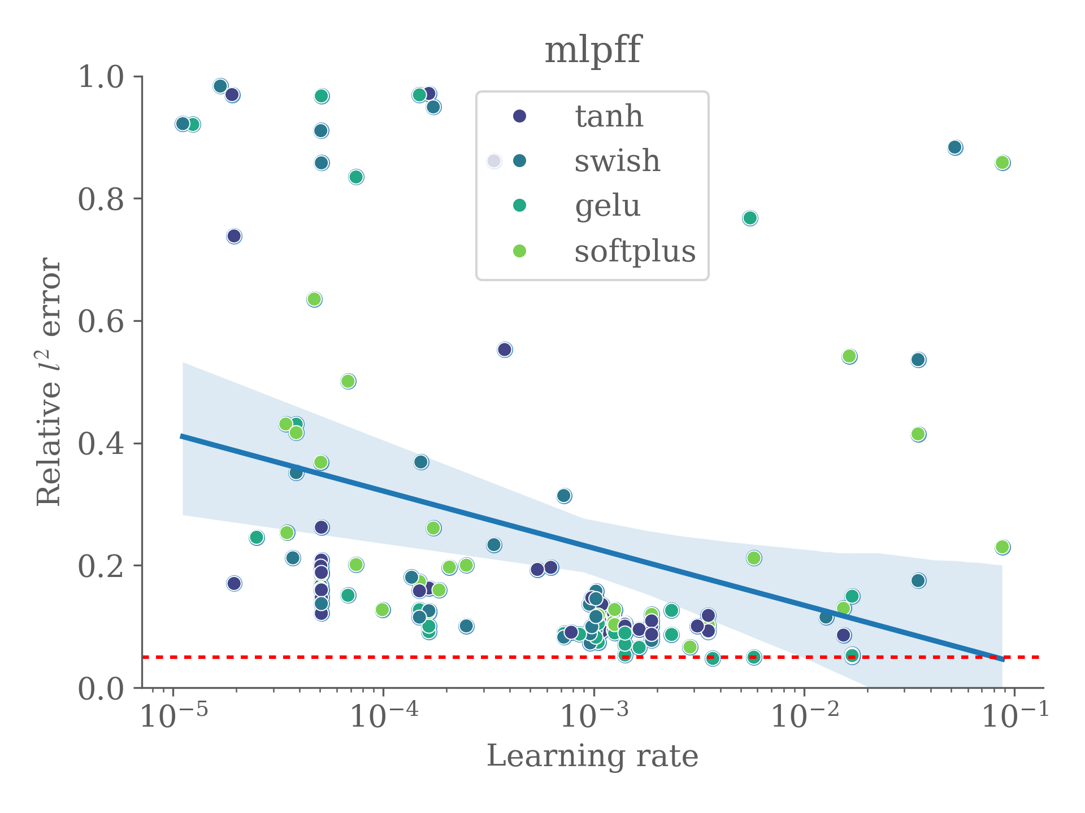
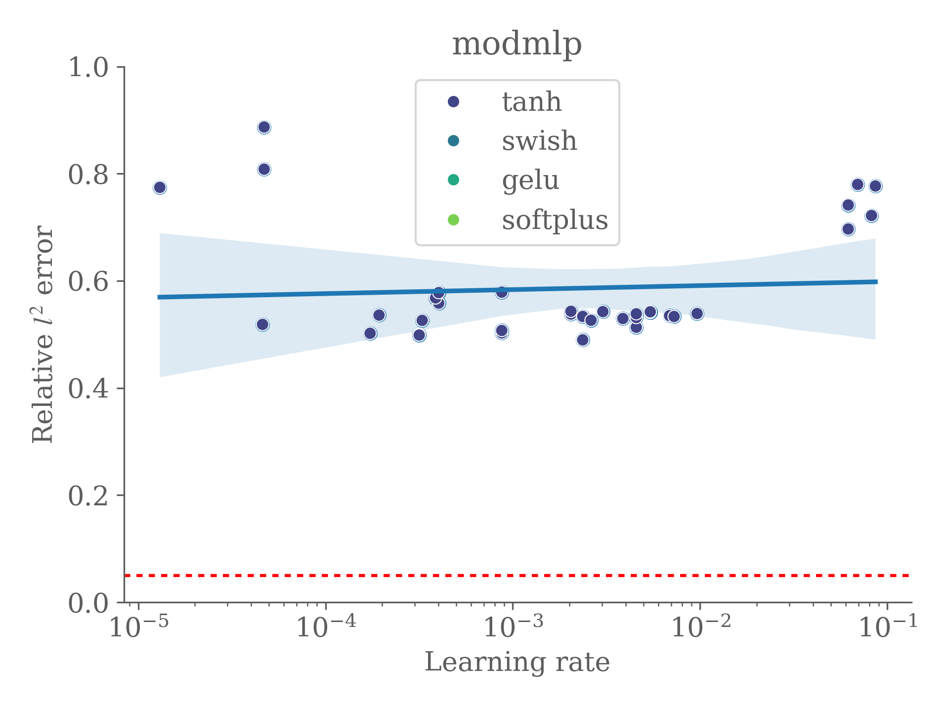
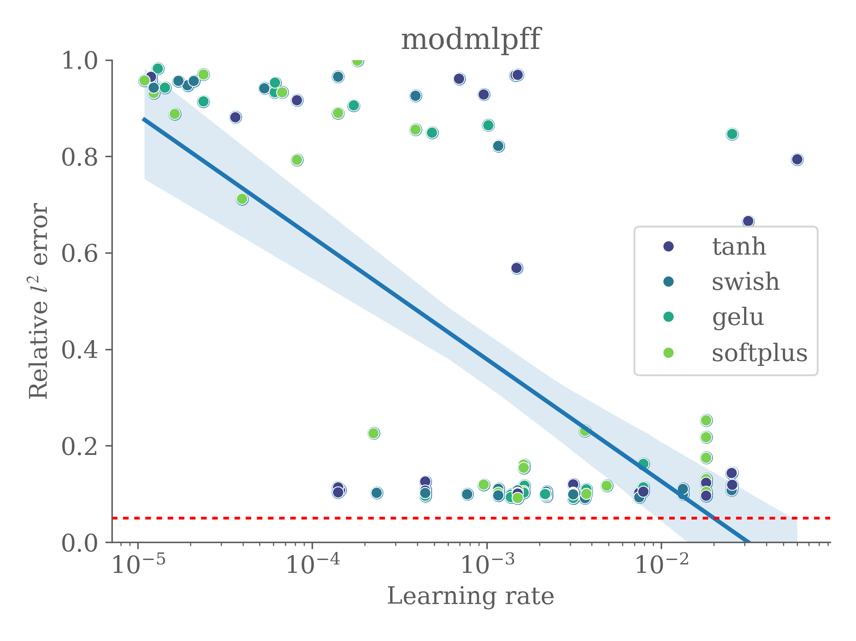
Learning rate

Slide 16
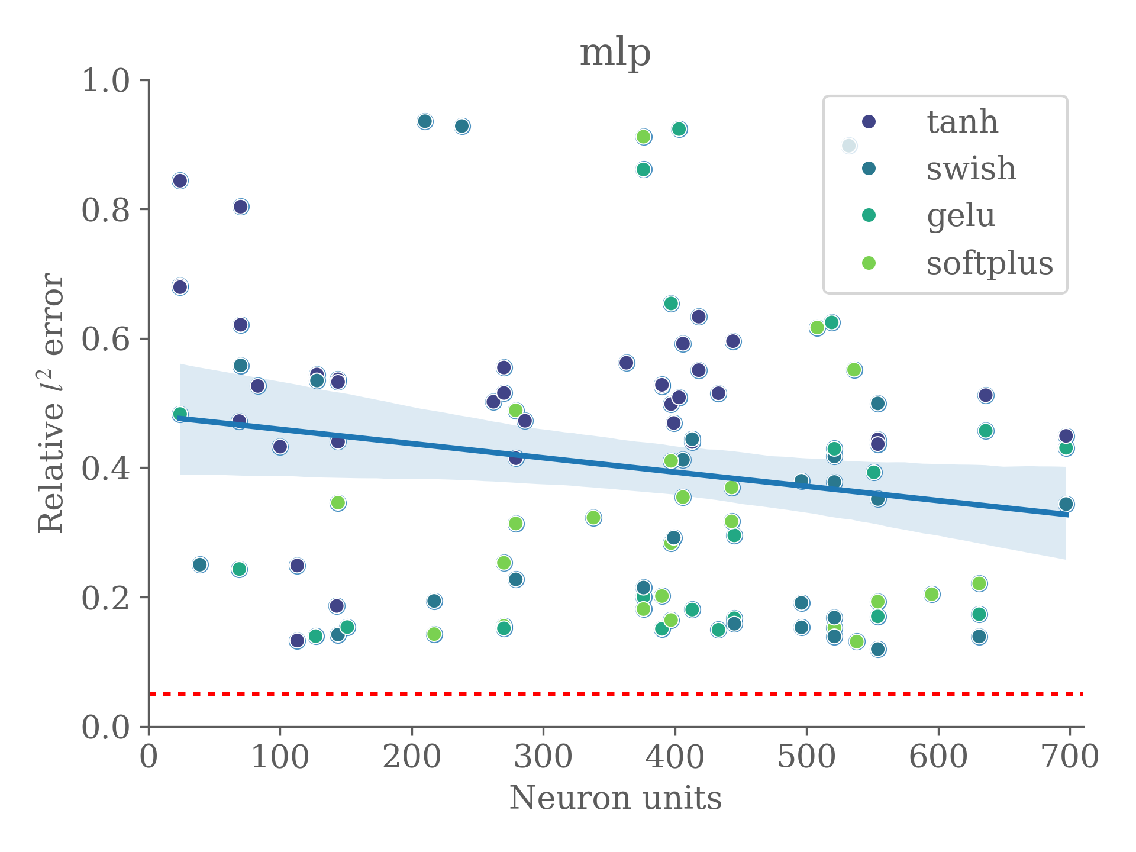
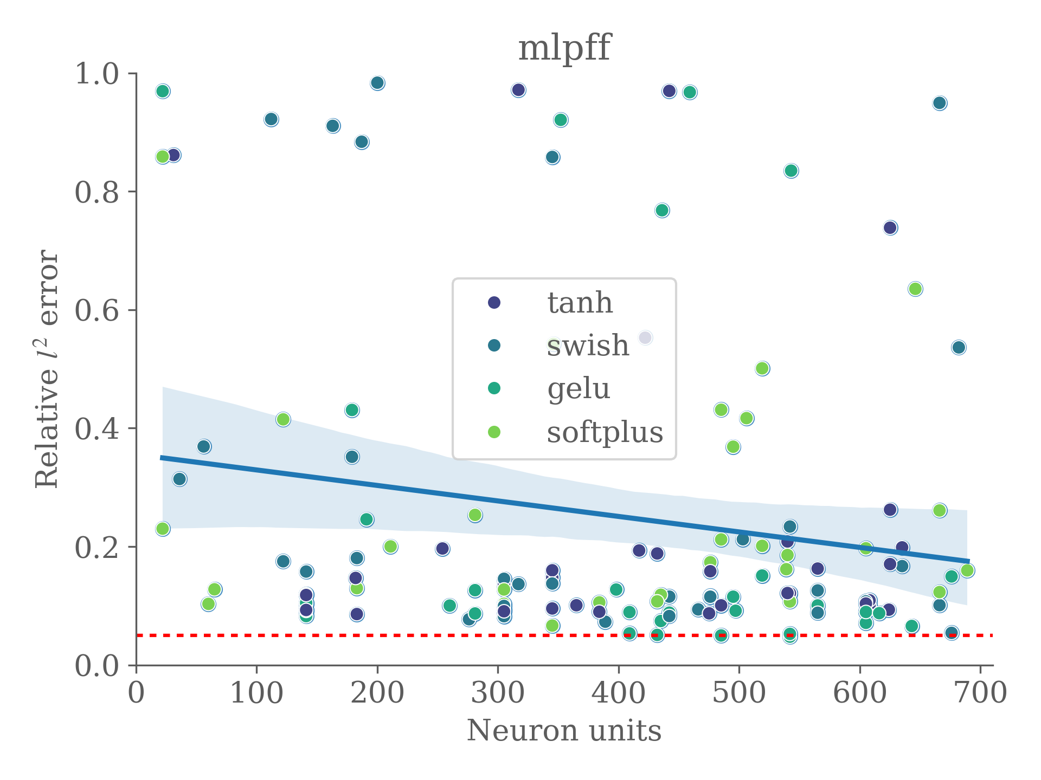
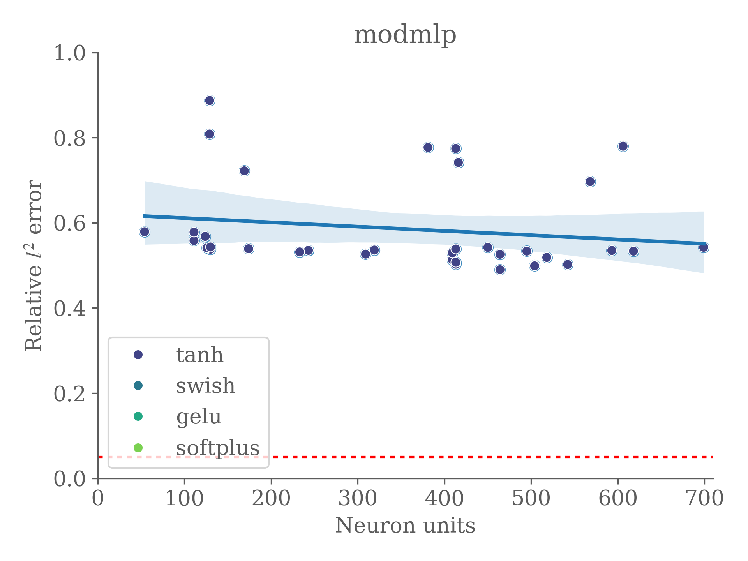
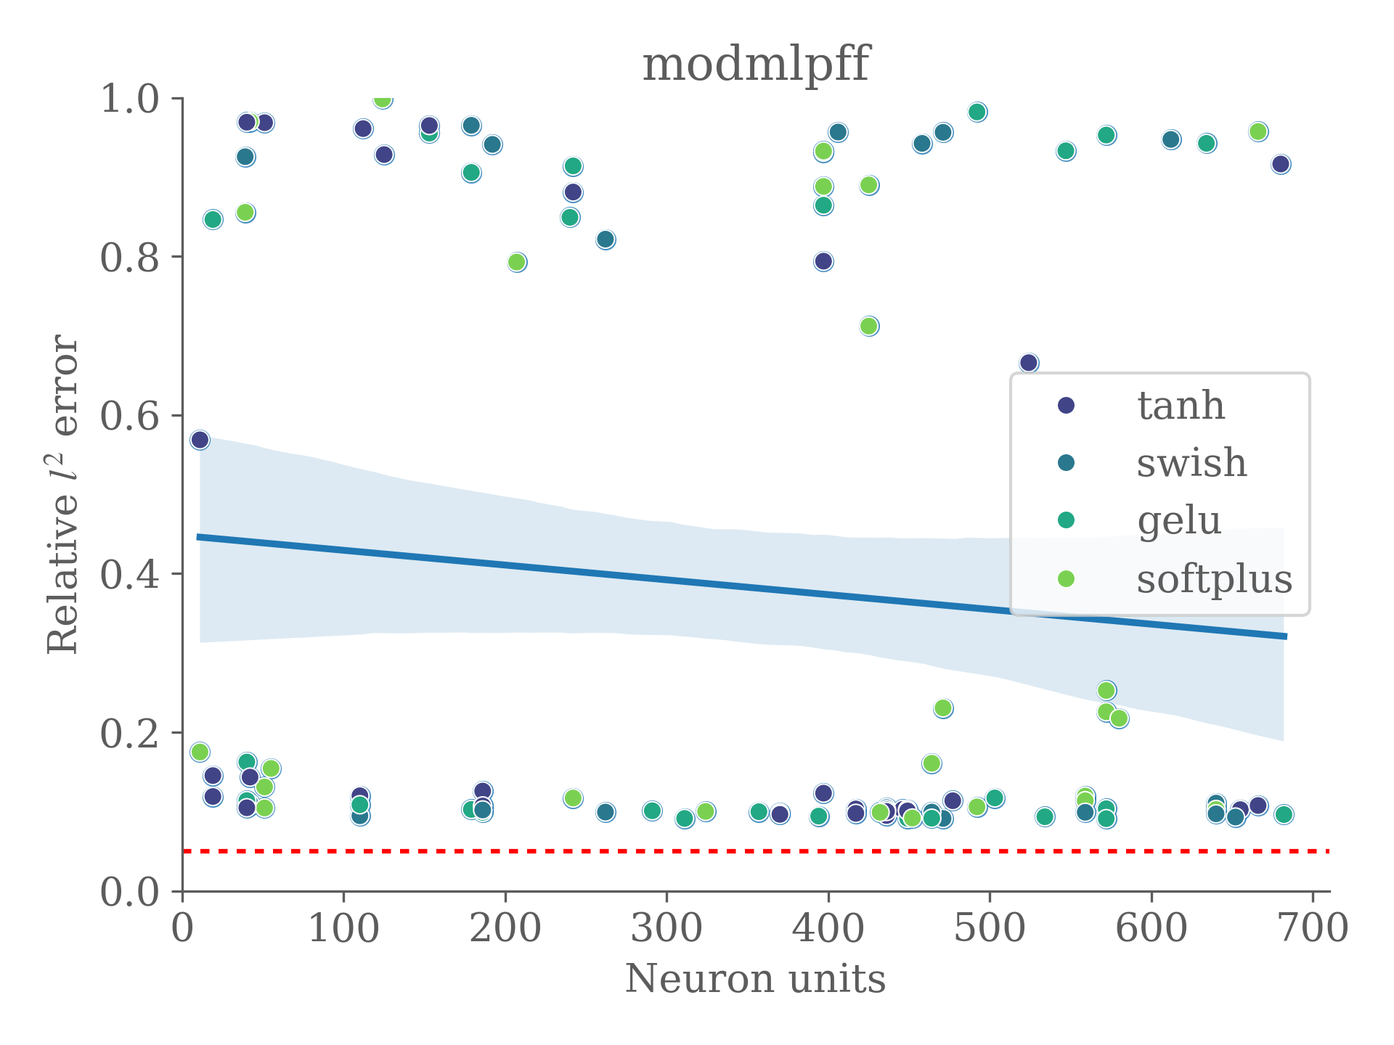
Neuron units

Slide 17
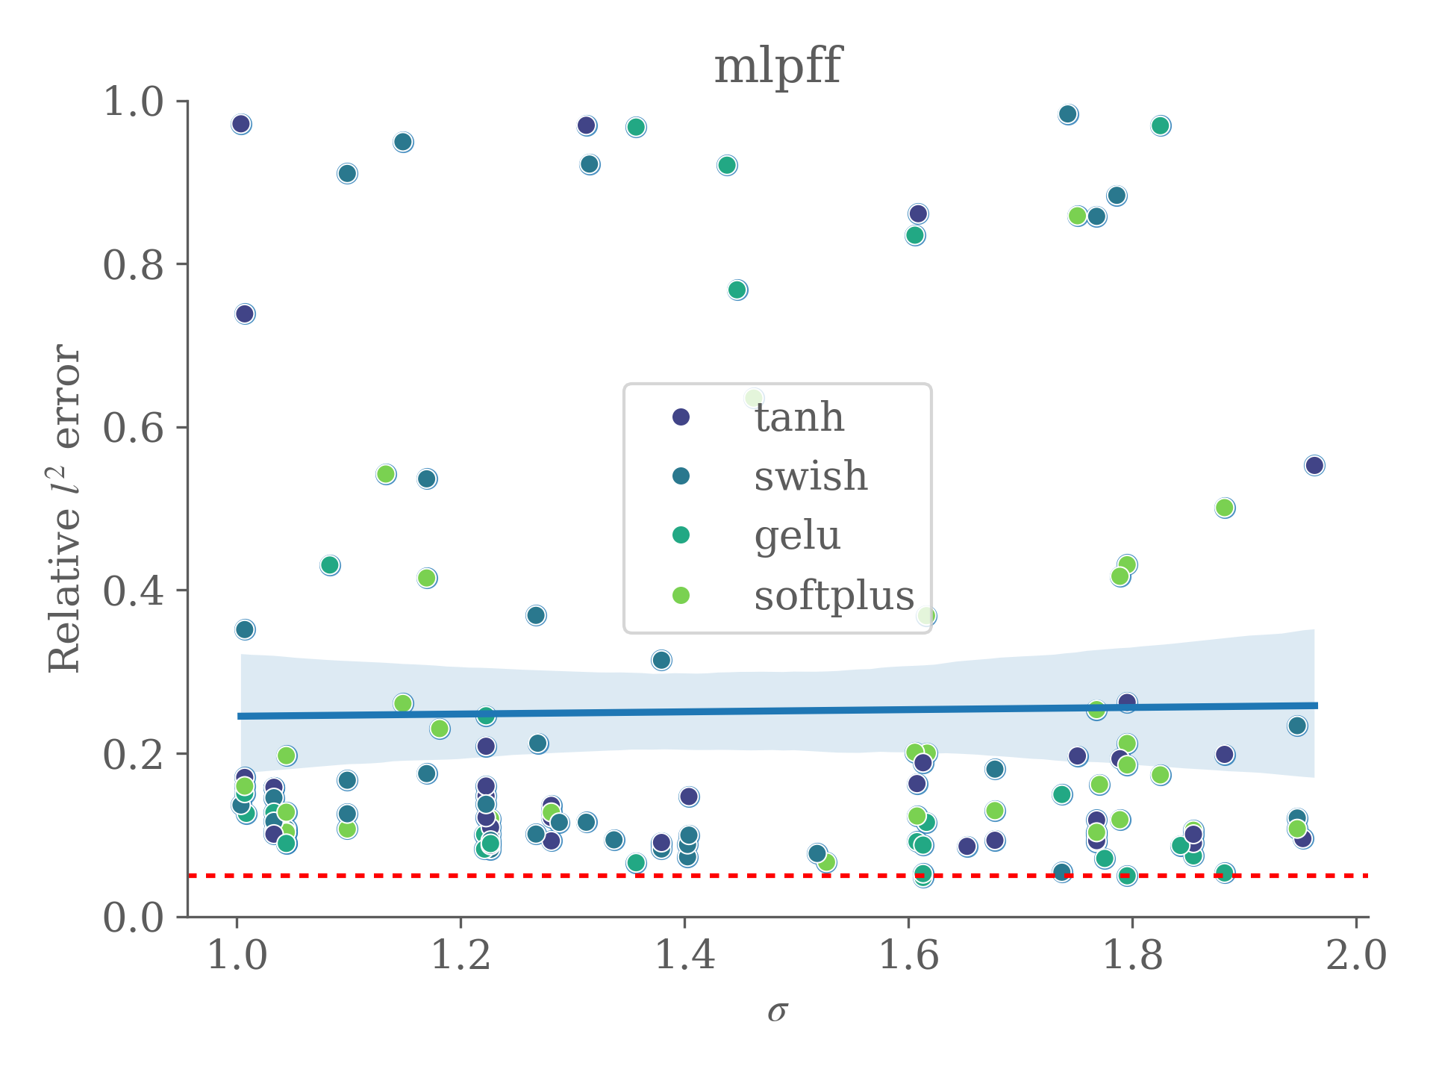
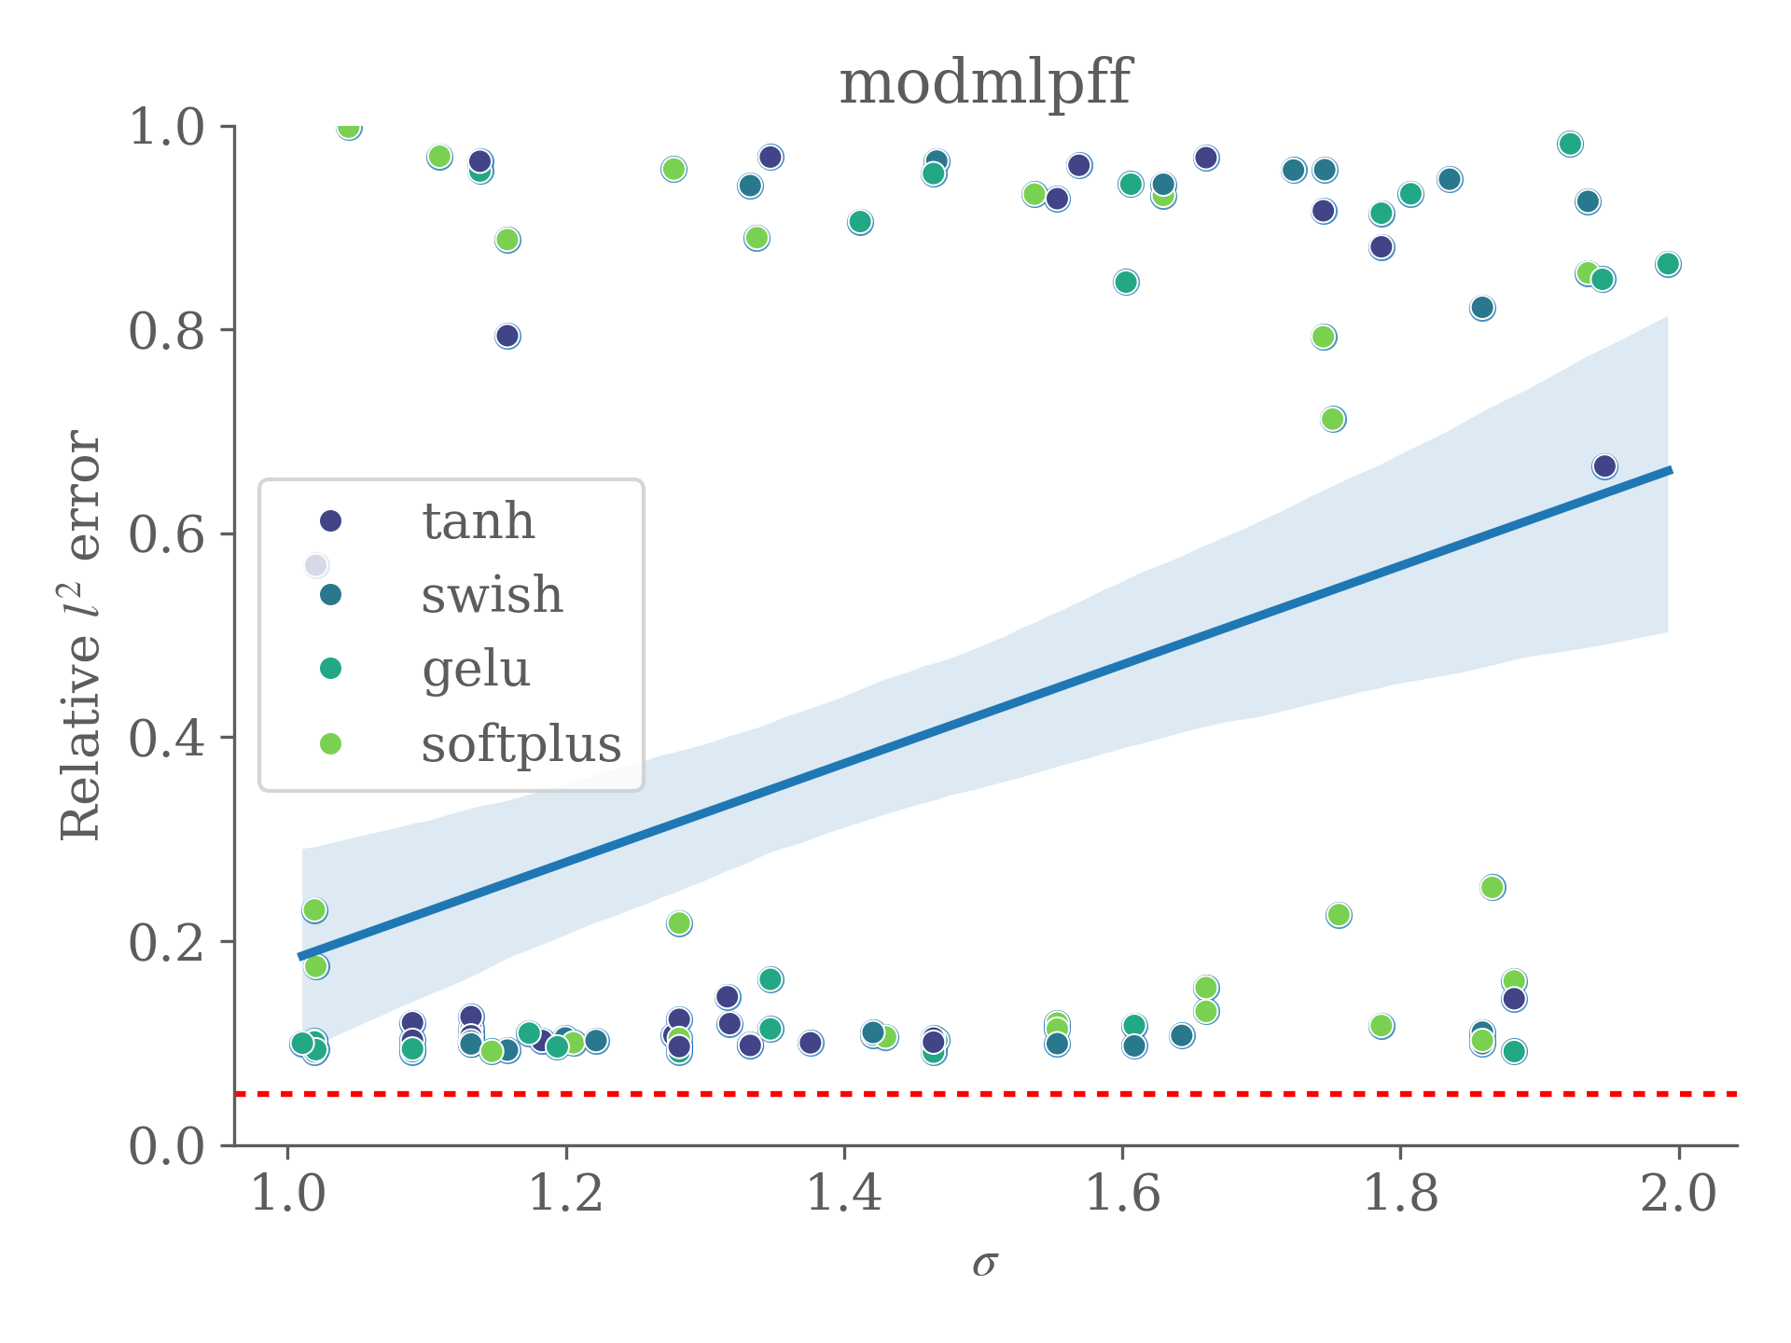
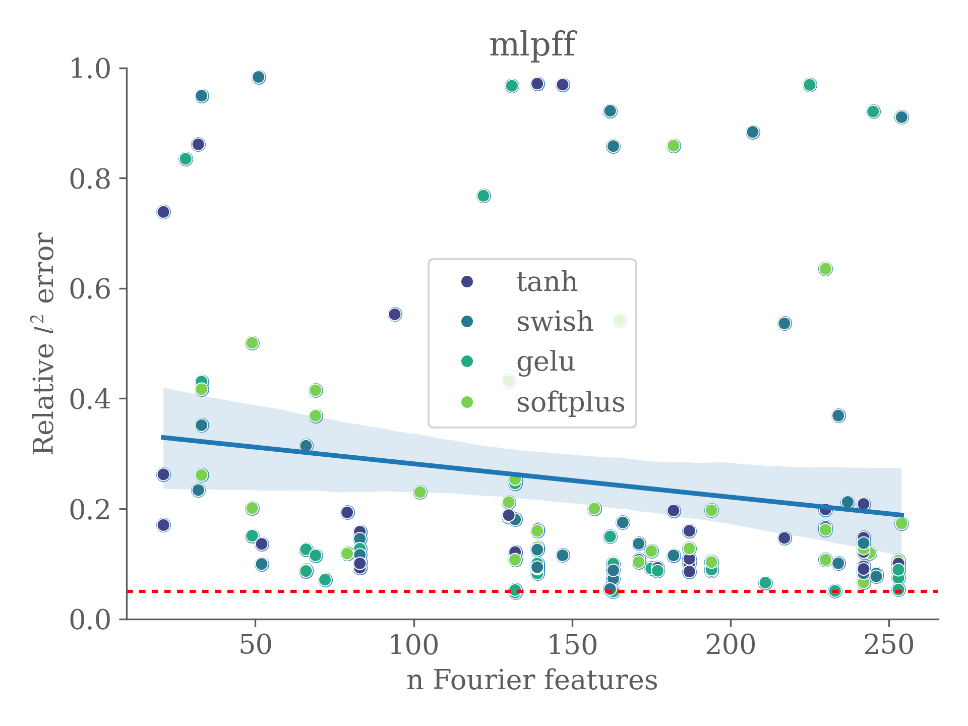
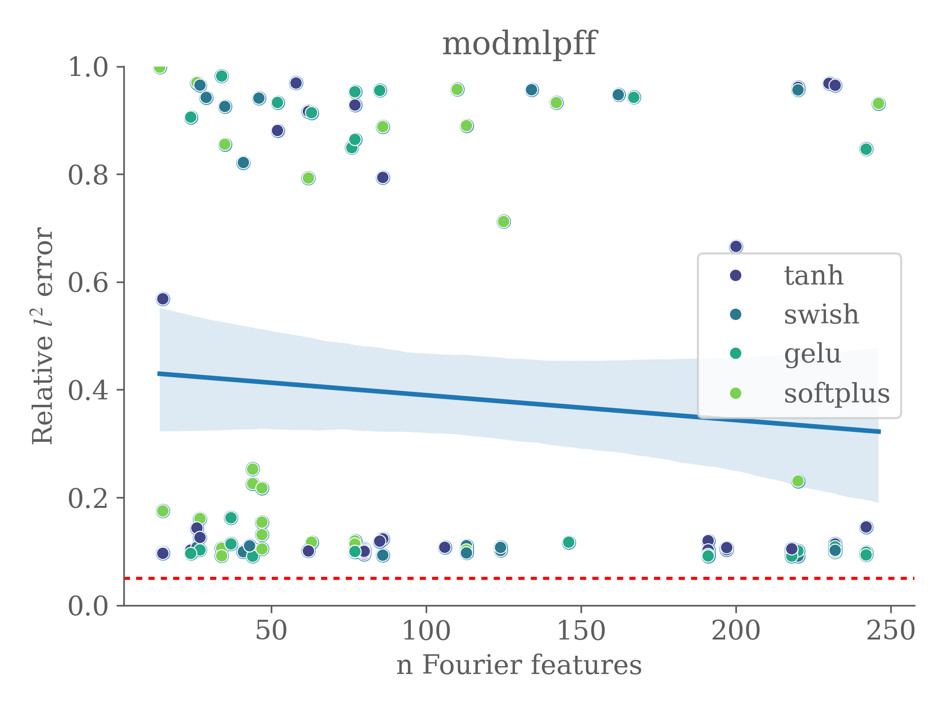
Sigma
N. features

Slide 18
To be included in the paper (working on)
Test noise robustness and parameter initialization
Test with a smaller input data set
Statistical tests
Some conclusions
Efficiency of Fourier Features in Neural Networks
MLP "outperforms" the modMLP
Relevant parameters: activation functions, hidden layers, learning rate

Slide 19







Acknowledgment
Thank you for your attention!
David Ortiz-Puerta
dortiz5@uc.cl
This work was funded by ANID - Millennium Science Initiative Program - ICN2021_004

